Slide 1
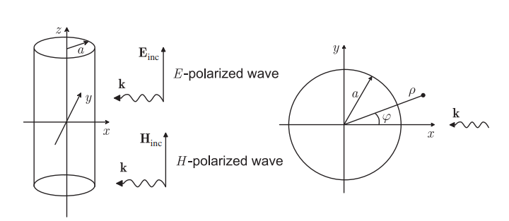
SOLAT Absolute Polarization Test
——Sparse Wire Grids (SWG) Simulation
Scatter width of a single wire of SWG
A planar wave scattered by a PEC cylinder with infinite length

